Slide 1
Review of Statistics
Elizabeth Tipton
NSF Improving Education R&D Evaluations Workshop
2021

Slide 2
A warm-up
Throughout the week, the text, lectures, and labs will use statistical notation.
It’s important that we begin with shared language and notation.
In this session, I’m going to give a ‘warm-up’, a high -level review of statistics.
Please ask questions.

Slide 3
Populations and Samples

Slide 4
Overview
A population is the conceivable (and possibly infinite) set of possible observations.
A sample is a subset of a population that can be observed.
Samples can be small or large and can be selected from the population in any possible way.

Slide 5
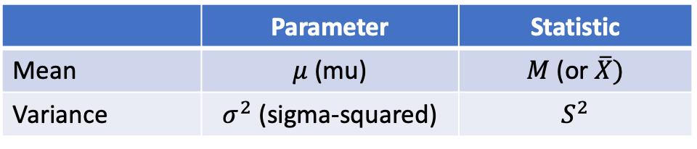
Notation
Characteristics of populations are called parameters.
Characteristics of samples are called statistics.
We typically use Greek letters for parameters and Roman letters for statistics.
 | Parameter | Statistic
Mean | $μ$ (mu) | $M$ (or $\overline{X})$
Variance | $σ^{2}$ (sigma-squared) | $$S^{2}$$

Slide 6
Random Sampling

Slide 7
Descriptive statistics
In a sample, we can summarize the data using statistics.
”The sample mean is 4.2.”
“ The variance in our sample is 1.3.”
These can be calculated (i.e., there is a formula) using data that we have collected. We definitively *know* these values.

Slide 8
Sample -> Population link
We can also use the statistics in our sample to estimate associated population parameters.
Remember: we can never definitively know these parameter values.
To get from a sample to a population, we need random sampling.

Slide 9
Random sampling
In random sampling, every unit (e.g., student, school) in the population has a non-zero probability of being in the sample.
This provides the bridge we need to make inferences.
Thinking this way shifts our perspective. Now the sample we observe is not the only sample, but one of an infinite number of possible samples we could have observed.
So, while the mean in our sample is 4.2, in another sample from the same population, the mean could have been 5.1 (or 3.9 or 4.1 or 1.2 …).

Slide 10
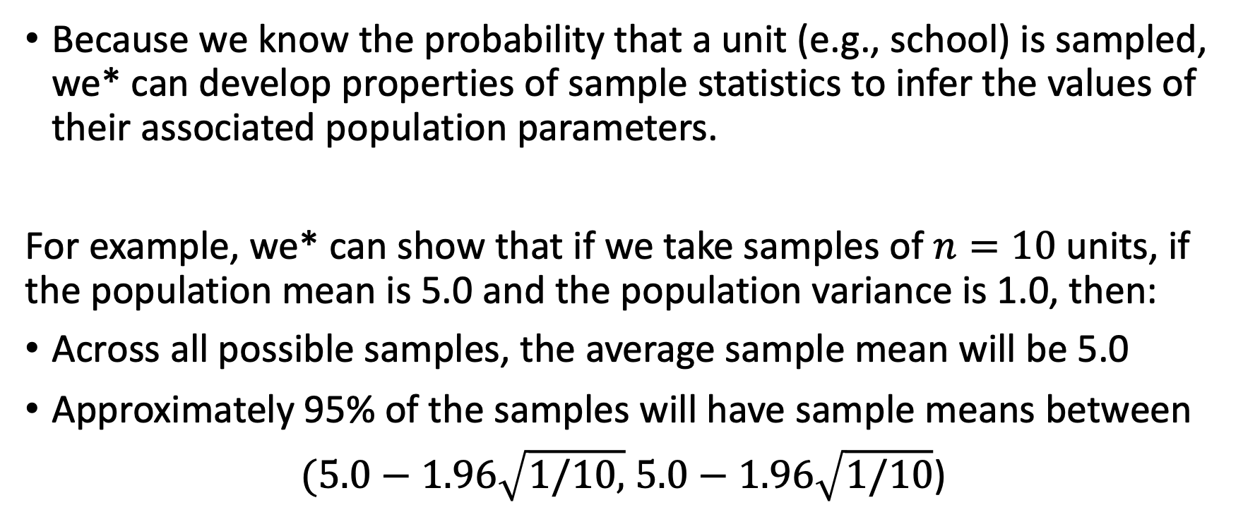
The bridge
* We = statisticians ☺
Because we know the probability that a unit (e.g., school) is sampled, we* can develop properties of sample statistics to infer the values of their associated population parameters.
For example, we* can show that if we take samples of $n=10$ units, if the population mean is 5.0 and the population variance is 1.0, then:
Across all possible samples, the average sample mean will be 5.0
Approximately 95% of the samples will have sample means between
$(5.0−1.96\sqrt{1/10,}$ $5.0−1.96\sqrt{1/10}$)

Slide 11
Is this right?
“But our samples aren’t random?” “And didn’t we say that we weren’t going to generalize to populations?”
This is where it gets a bit dicey. Even though the sample you see is not a random sample from a larger target population, it *can* be conceived of as a random sample from *some* population.

Slide 12
Models and Notation

Slide 13
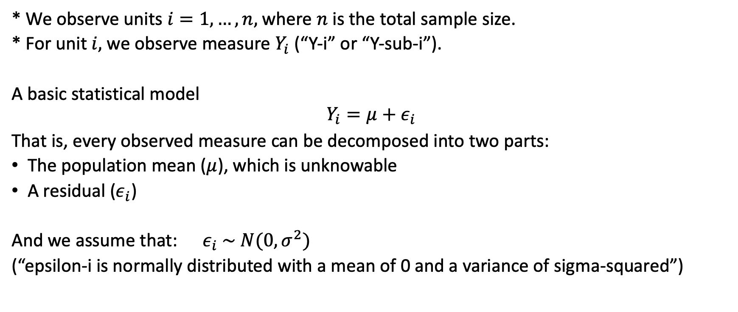
Notation we will use
* We observe units $i=1,…,n,$ where $n$ is the total sample size.
* For unit $i,$ we observe measure $Y_{i}$ (“Y-i” or “Y-sub-i”).
A basic statistical model
$$Y_{i}=μ+ε_{i}$$
That is, every observed measure can be decomposed into two parts:
The population mean ($μ$), which is unknowable
A residual ($ε_{i}$)
And we assume that: $ε_{i} \sim N(0,σ^{2})$
(“epsilon-i is normally distributed with a mean of 0 and a variance of sigma-squared”)

Slide 14
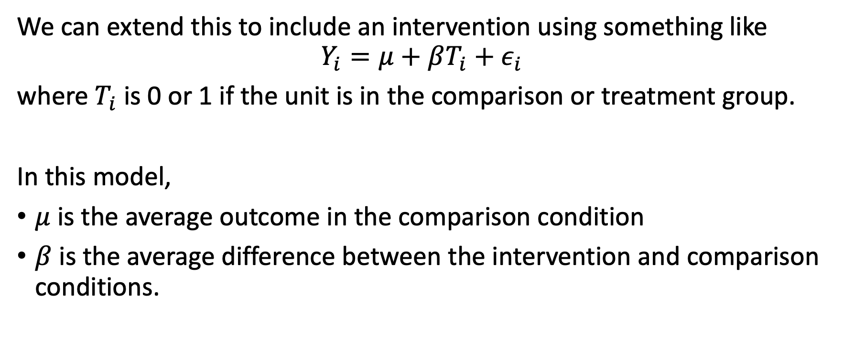
Now with an intervention
We can extend this to include an intervention using something like
$$Y_{i}=μ+βT_{i}+ε_{i}$$
where $T_{i}$ is 0 or 1 if the unit is in the comparison or treatment group.
In this model,
$μ$ is the average outcome in the comparison condition
$β$ is the average difference between the intervention and comparison conditions.

Slide 15
Estimators and Sampling Distributions

Slide 16
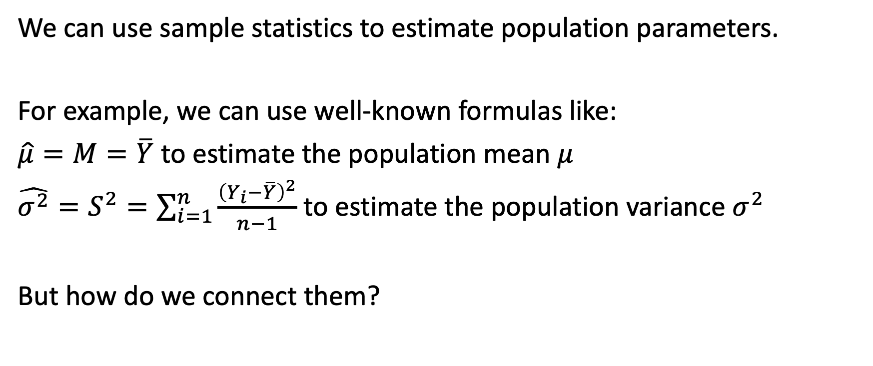
Estimating parameters
We can use sample statistics to estimate population parameters.
For example, we can use well-known formulas like:
$\hat{μ}=M=\overline{Y}$ to estimate the population mean $μ$
$\hat{σ^{2}}=S^{2}=\sum_{i=1}^{n}{\frac{{\left(Y_{i}−\overline{Y}\right)}^{2}}{n−1}}$ to estimate the population variance $σ^{2}$
But how do we connect them?

Slide 17
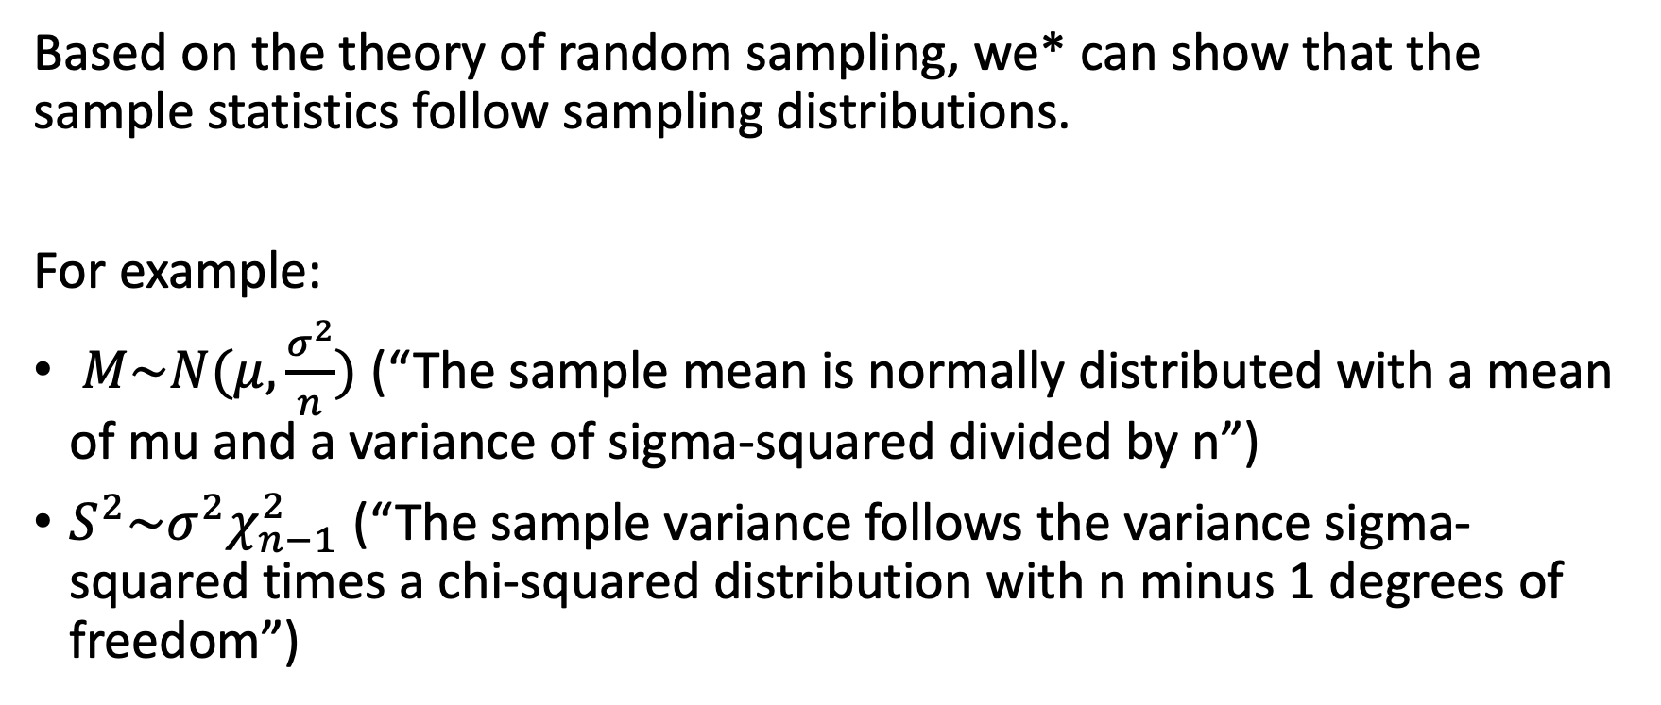
Sampling distributions
* We = statisticians ☺
Based on the theory of random sampling, we* can show that the sample statistics follow sampling distributions.
For example:
$M\sim N(μ,\frac{σ^{2}}{n})$ (“The sample mean is normally distributed with a mean of mu and a variance of sigma-squared divided by n”)
$S^{2}\sim σ^{2}χ_{n−1}^{2}$ (“The sample variance follows the variance sigma-squared times a chi-squared distribution with n minus 1 degrees of freedom”)

Slide 18
In practice
If we know the sampling distribution and our sample statistics, we can now use these distributions to infer how close our estimate is likely to be to the true parameter value.
For example, we can use this sampling distribution to create:
A confidence interval
A hypothesis test

Slide 19
Statistical Inference

Slide 20
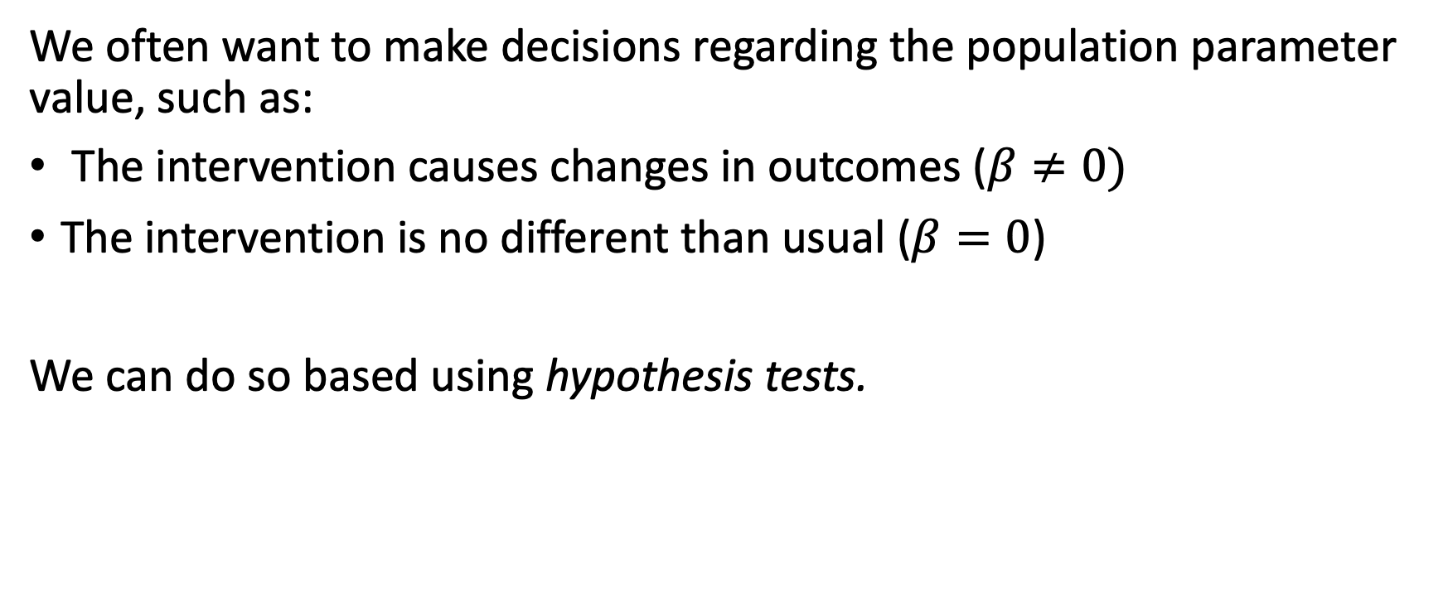
Decision making with data
We often want to make decisions regarding the population parameter value, such as:
The intervention causes changes in outcomes ($β≠0)$
The intervention is no different than usual ($β=0$)
We can do so based using hypothesis tests.

Slide 21
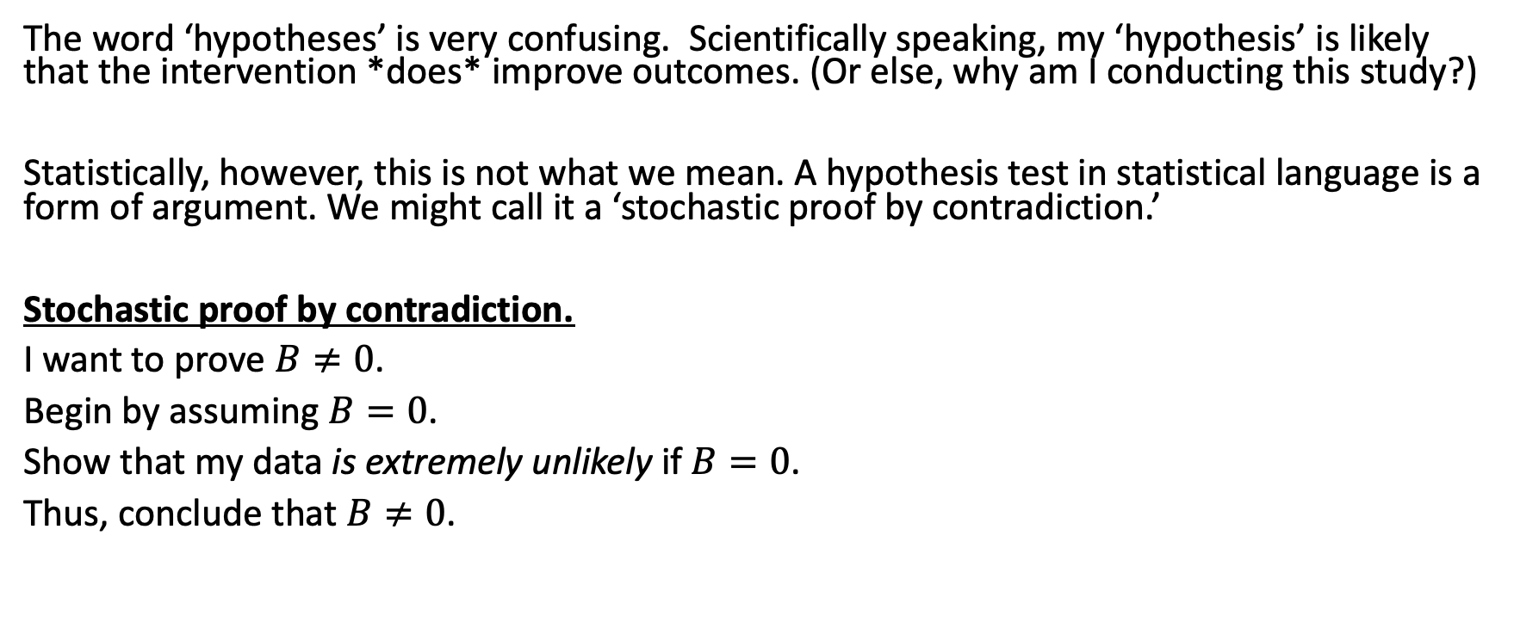
Scientific vs Statistical Hypotheses
The word ‘hypotheses’ is very confusing. Scientifically speaking, my ‘hypothesis’ is likely that the intervention *does* improve outcomes. (Or else, why am I conducting this study?)
Statistically, however, this is not what we mean. A hypothesis test in statistical language is a form of argument. We might call it a ‘stochastic proof by contradiction.’
Stochastic proof by contradiction.
I want to prove $B≠0$.
Begin by assuming $B=0$.
Show that my data is extremely unlikely if$B=0$.
Thus, conclude that $B≠0$.

Slide 22
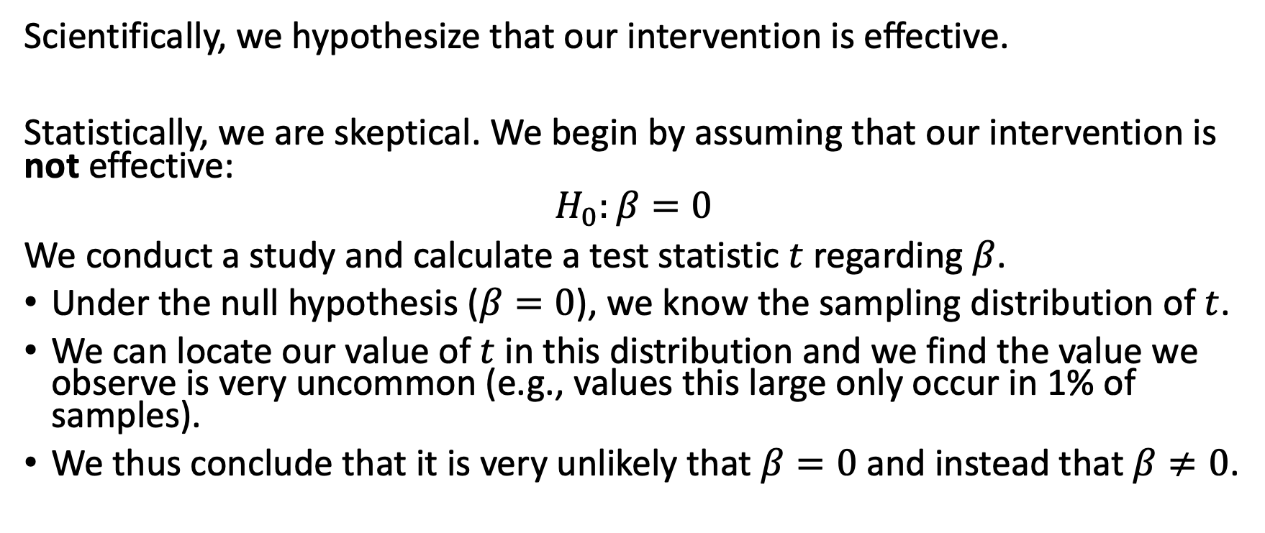
Null hypothesis testing
Scientifically, we hypothesize that our intervention is effective.
Statistically, we are skeptical. We begin by assuming that our intervention is not effective:
$$H_{0}:β=0$$
We conduct a study and calculate a test statistic $t$regarding $β$.
Under the null hypothesis ($β=0$), we know the sampling distribution of $t$.
We can locate our value of $t$ in this distribution and we find the value we observe is very uncommon (e.g., values this large only occur in 1% of samples).
We thus conclude that it is very unlikely that $β=0$ and instead that $β≠0$.

Slide 23
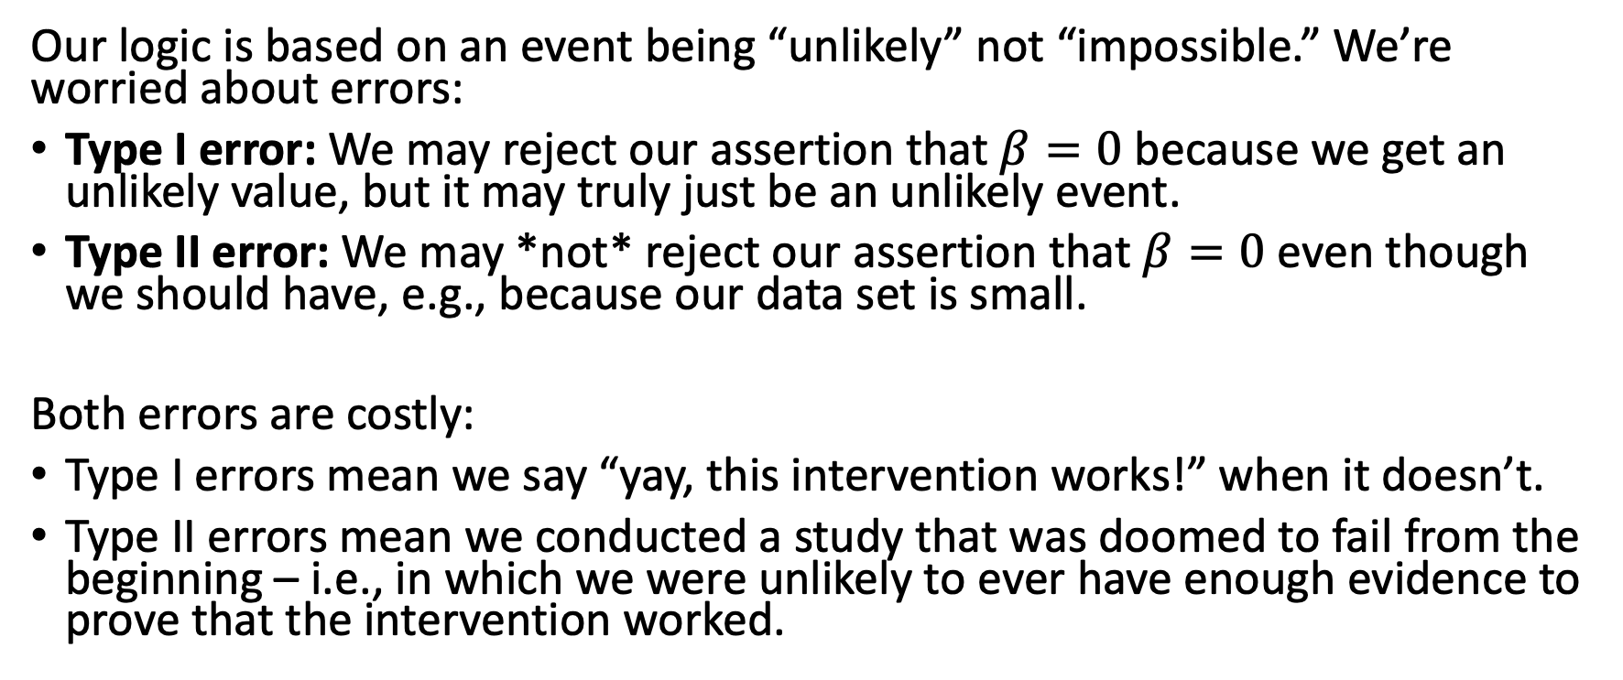
But this is a stochastic proof
Our logic is based on an event being “unlikely” not “impossible.” We’re worried about errors:
Type I error: We may reject our assertion that $β=0$ because we get an unlikely value, but it may truly just be an unlikely event.
Type II error: We may *not* reject our assertion that $β=0$ even though we should have, e.g., because our data set is small.
Both errors are costly:
Type I errors mean we say “yay, this intervention works!” when it doesn’t.
Type II errors mean we conducted a study that was doomed to fail from the beginning – i.e., in which we were unlikely to ever have enough evidence to prove that the intervention worked.

Slide 24
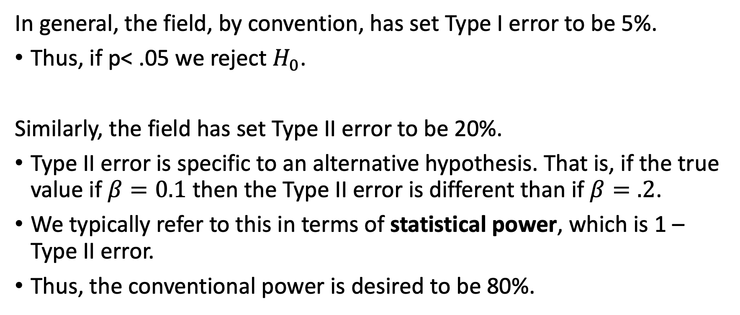
Statistical power
In general, the field, by convention, has set Type I error to be 5%.
Thus, if p< .05 we reject $H_{0}$.
Similarly, the field has set Type II error to be 20%.
Type II error is specific to an alternative hypothesis. That is, if the true value if $β=0.1$ then the Type II error is different than if $β=.2$.
We typically refer to this in terms of statistical power, which is 1 – Type II error.
Thus, the conventional power is desired to be 80%.

Slide 25
Effect Sizes

Slide 26
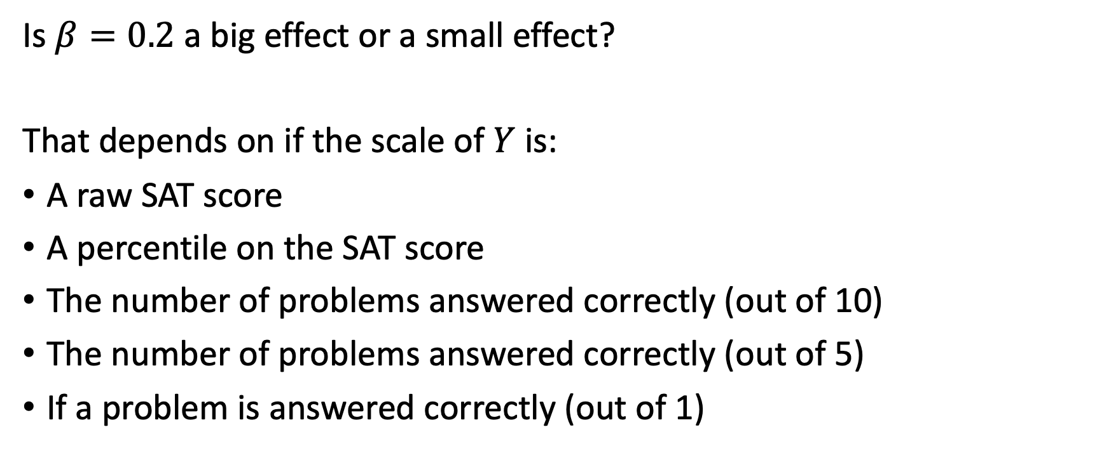
Common scales
Is $β=0.2$ a big effect or a small effect?
That depends on if the scale of $Y$ is:
A raw SAT score
A percentile on the SAT score
The number of problems answered correctly (out of 10)
The number of problems answered correctly (out of 5)
If a problem is answered correctly (out of 1)

Slide 27
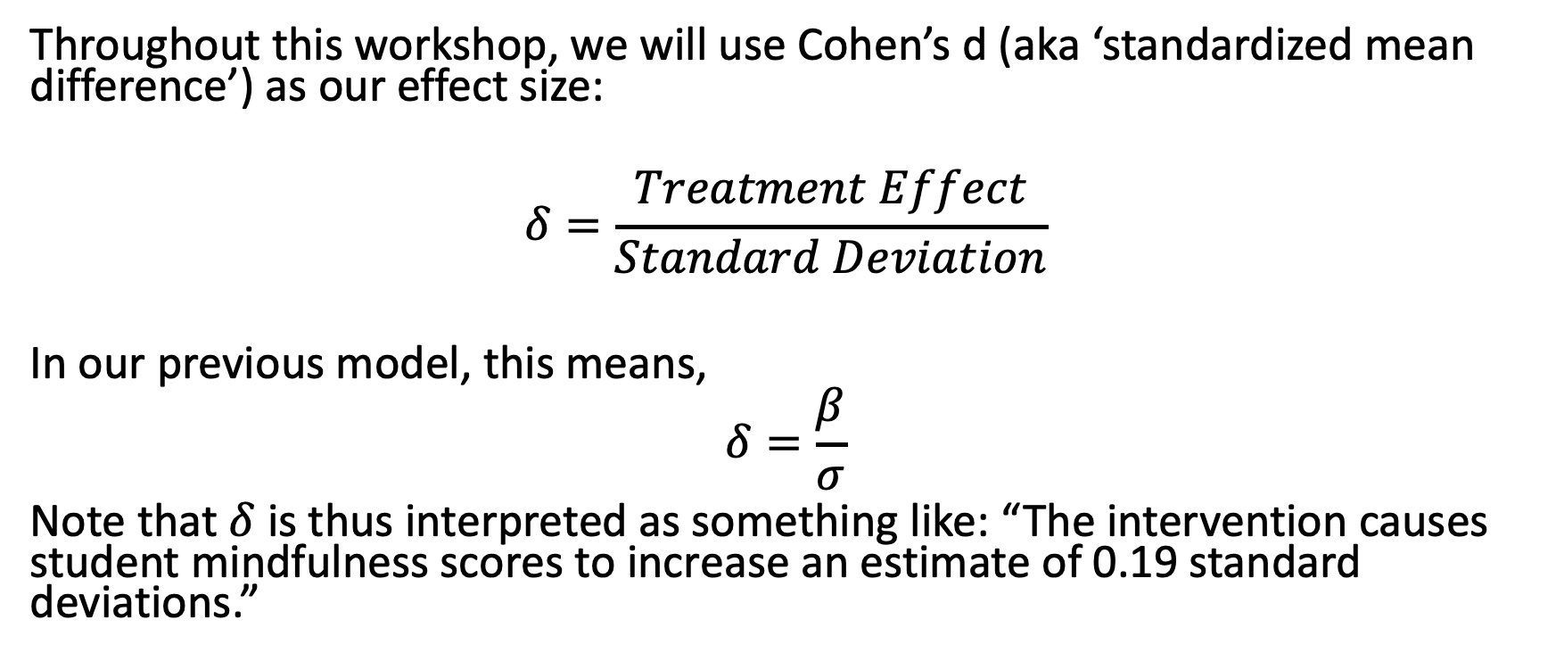
Effect sizes use a common scale
Throughout this workshop, we will use Cohen’s d (aka ‘standardized mean difference’) as our effect size:
$$δ=\frac{Treatment Effect}{Standard Deviation}$$
In our previous model, this means,
$$δ=\frac{β}{σ}$$
Note that $δ$ is thus interpreted as something like: “The intervention causes student mindfulness scores to increase an estimate of 0.19 standard deviations.”

Slide 28
Measurement and effect size
The reliability of the measurement of the outcome variable has an important relation with the effect size.
It does *not* affect the numerator (the difference)
It *does* affect the denominator (the standard deviation)
In general, the lower the reliability, the smaller the effect size. (Thus improving the reliability of a test can increase the effect size).

Slide 29
Alignment of measures and effect size
The alignment of the measure and intervention can have a large effect on the numerator (the mean difference).
A measure that is proximal (highly aligned) with the intervention will lead to a larger effect size.
A measure that is distal (e.g., standardized) with the intervention will lead to a smaller effect size.

Slide 30
Design Sensitivity

Slide 31
3 ways to talk about sensitivity
Statistical power
Minimal detectable effect size
Precision

Slide 32
Design Complexities and Models

Slide 34
Factors, Covariates, and Blocks

Slide 35
3 confusing concepts
Factor: A variable that is manipulated by randomly assigning their values.
Covariate: Any variable that cannot be affected by the treatment (intervention or comparison) but that are correlated with the outcome.
Block: A categorical covariate.
Naturally occurring: Schools, districts.
Discretized characteristics: SES, urbanicity, etc.

Slide 36
Cluster Sampling

Slide 37
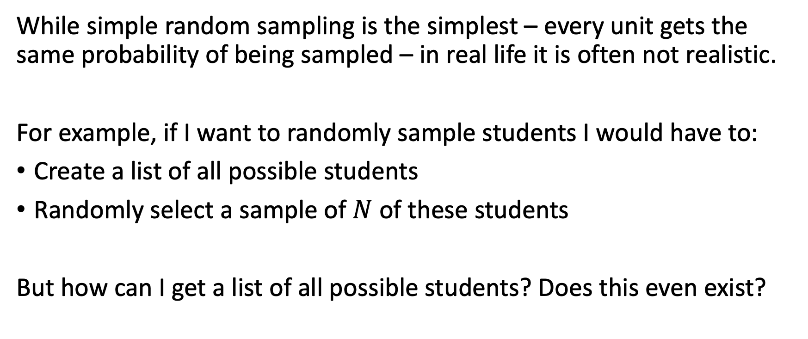
Simple random sampling
While simple random sampling is the simplest – every unit gets the same probability of being sampled – in real life it is often not realistic.
For example, if I want to randomly sample students I would have to:
Create a list of all possible students
Randomly select a sample of $N$ of these students
But how can I get a list of all possible students? Does this even exist?

Slide 38
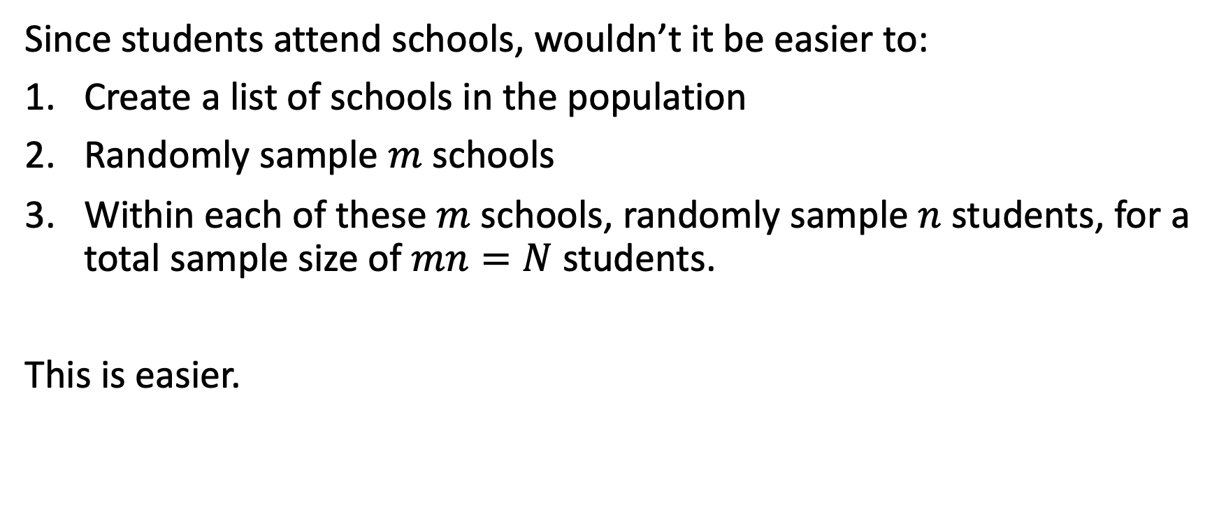
Two-stage sampling
Since students attend schools, wouldn’t it be easier to:
Create a list of schools in the population
Randomly sample $m$ schools
Within each of these $m$ schools, randomly sample $n$ students, for a total sample size of $mn=N$ students.
This is easier.

Slide 39
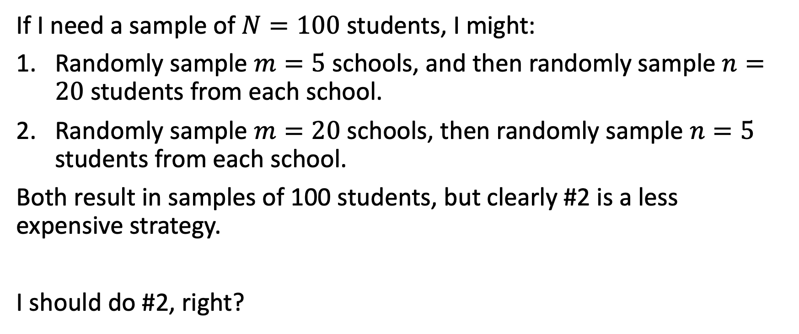
Two-stage decisions
If I need a sample of $N=100$ students, I might:
Randomly sample $m=5$ schools, and then randomly sample $n=20$ students from each school.
Randomly sample $m=20$ schools, then randomly sample $n=5$ students from each school.
Both result in samples of 100 students, but clearly #2 is a less expensive strategy.
I should do #2, right?

Slide 40
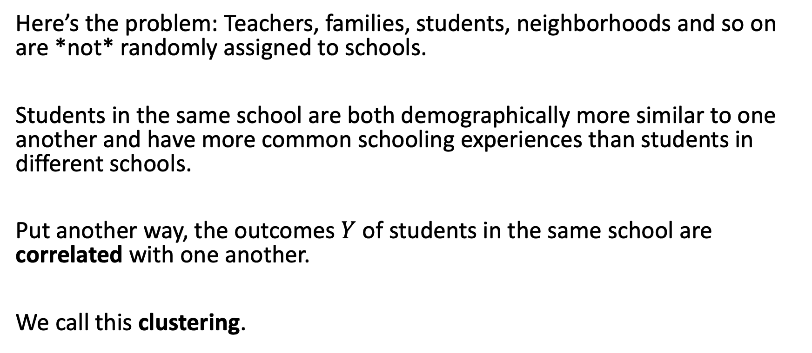
Clustering
Here’s the problem: Teachers, families, students, neighborhoods and so on are *not* randomly assigned to schools.
Students in the same school are both demographically more similar to one another and have more common schooling experiences than students in different schools.
Put another way, the outcomes $Y$ of students in the same school are correlated with one another.
We call this clustering.

Slide 41
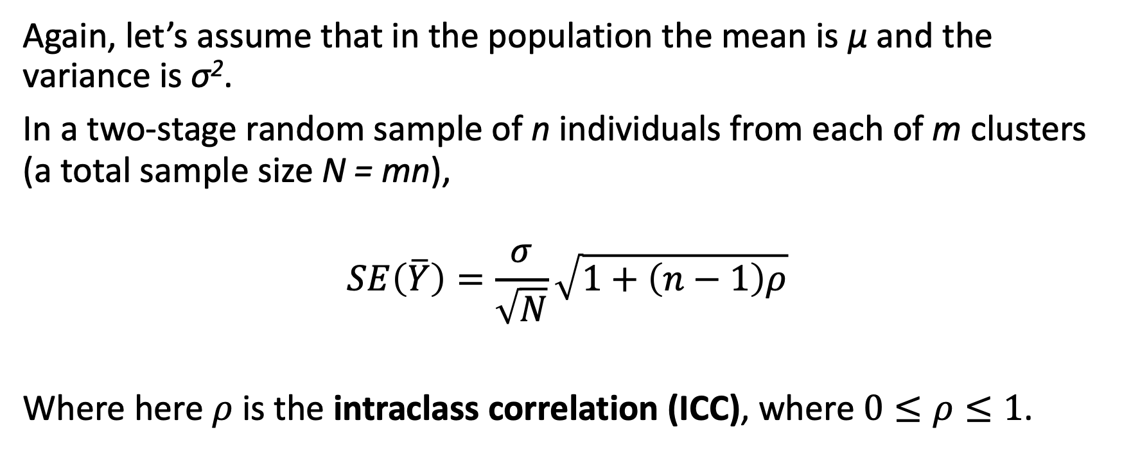
Intraclass correlation
Again, let’s assume that in the population the mean is μ and the variance is σ².
In a two-stage random sample of n individuals from each of m clusters (a total sample size N = mn),
$$SE\left(\overline{Y}\right)=\frac{σ}{\sqrt{N}}\sqrt{1+\left(n−1\right)ρ}$$
Where here $ρ$ is the intraclass correlation (ICC), where $0≤ρ≤1$.

Slide 42
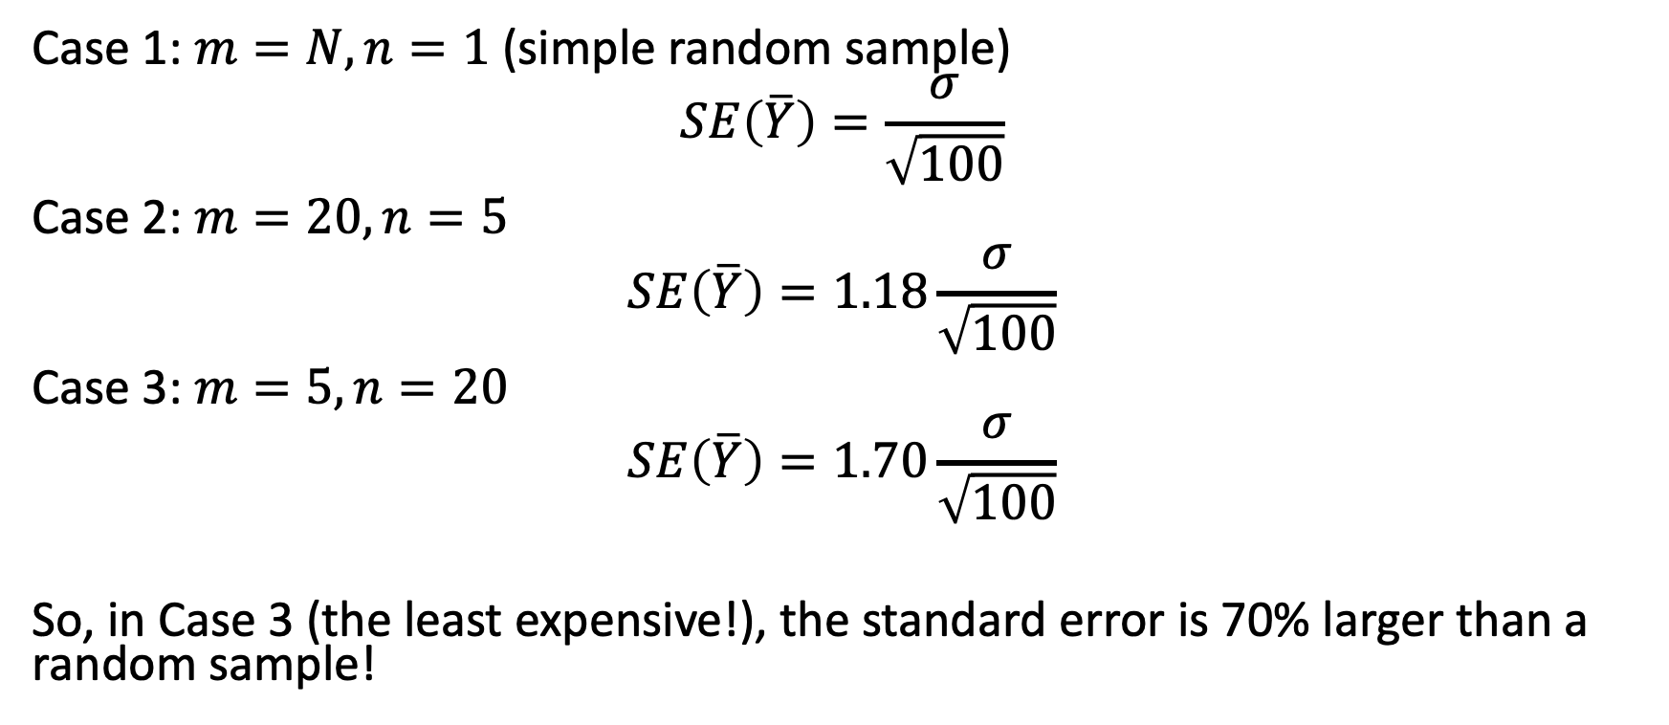
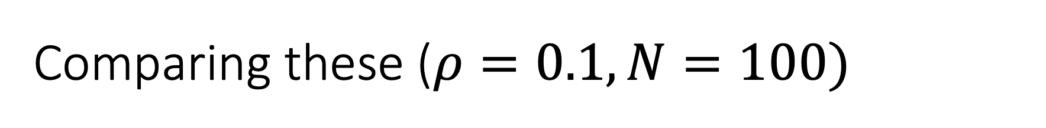
Comparing these ($ρ=0.1,N=100)$
Case 1: $m=N, n=1$ (simple random sample)
$$SE\left(\overline{Y}\right)=\frac{σ}{\sqrt{100}}$$
Case 2: $m=20, n=5$
$$SE\left(\overline{Y}\right)=1.18\frac{σ}{\sqrt{100}}$$
Case 3: $m=5, n=20$
$$SE\left(\overline{Y}\right)=1.70\frac{σ}{\sqrt{100}}$$
So, in Case 3 (the least expensive!), the standard error is 70% larger than a random sample!

Slide 43
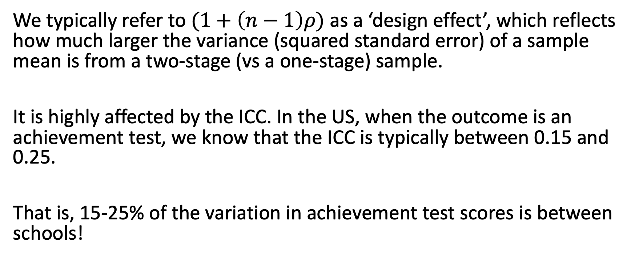
Design effect
We typically refer to $(1+\left(n−1\right)ρ)$ as a ‘design effect’, which reflects how much larger the variance (squared standard error) of a sample mean is from a two-stage (vs a one-stage) sample.
It is highly affected by the ICC. In the US, when the outcome is an achievement test, we know that the ICC is typically between 0.15 and 0.25.
That is, 15-25% of the variation in achievement test scores is between schools!

Slide 44
Clusters affect design
In most evaluations, nesting / clustering is just a fact of life. But it’s an important fact that has large implications for design.
There is a fundamental tension:
More clusters (schools) means greater precision and statistical power.
Fewer clusters (schools) is easier to implement and far less costly.
The general question is: What is the smallest number of clusters (schools) I can possibly include so that I have adequate power?

